Slide 1



Foreign Direct Investment
Any investment from an individual or firm that is located in a foreign country into a country is Foreign Direct Investment (FDI), whereby the foreign entity equires ownership or controlling stake in the shares of a company
​By
Sudipta Mahato​

Slide 2

Problem Statement
Have to conduct a detailed year-wise (from 2000-2017) analysis of the FDI landscape in India to uncover sector-wise trends, peaks and troughs by identifying key metrics and factors and show meaningful relationships between various attributes to mitigate risk and find equilibrium investment.

Slide 3
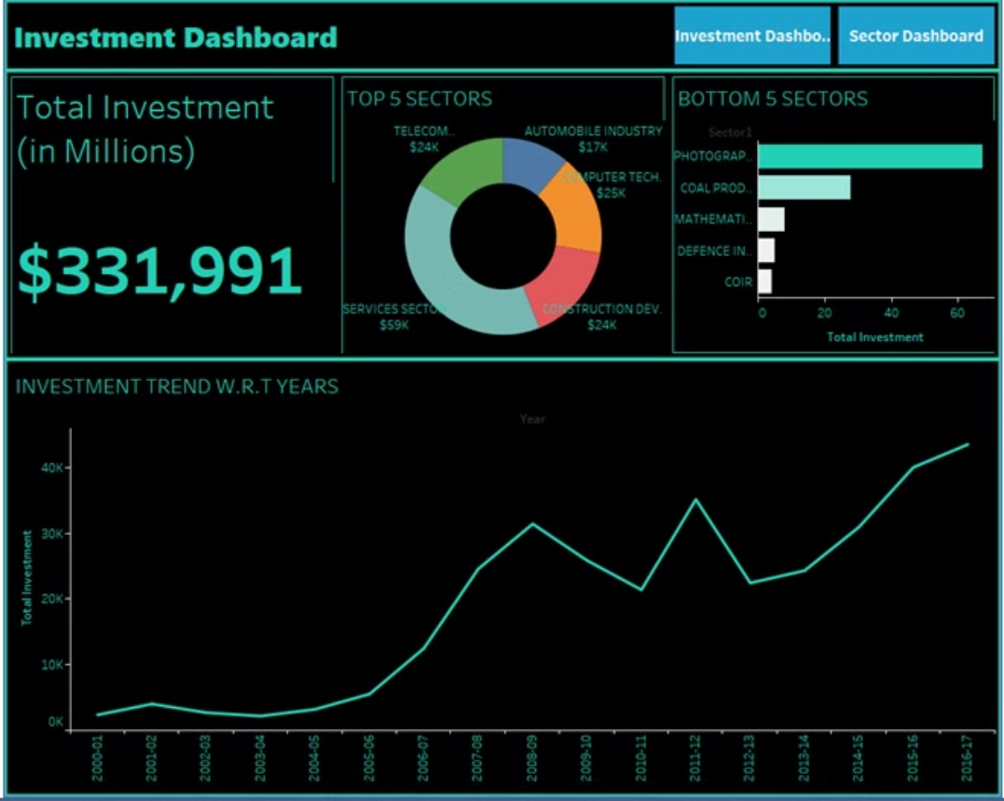
Dashboard 1

Slide 4
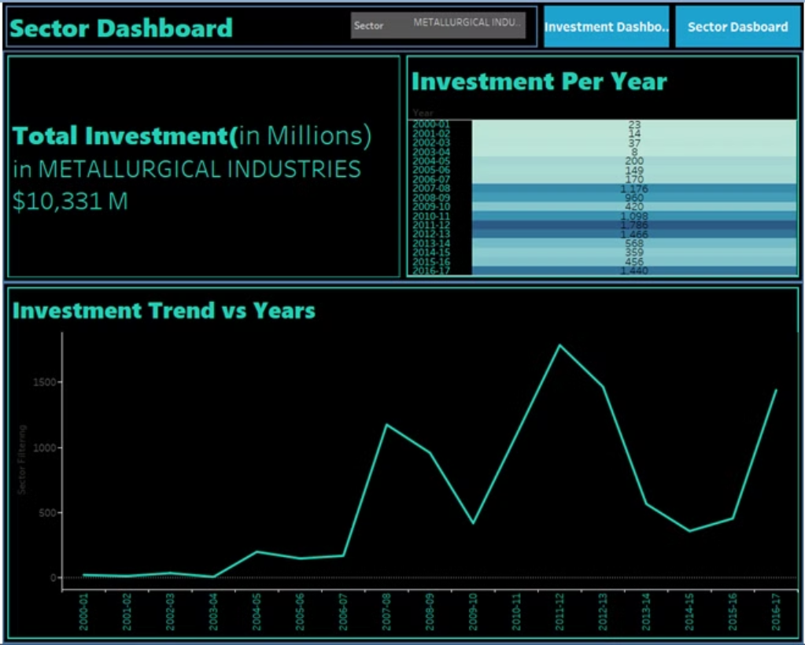
Dashboard 2

Slide 5
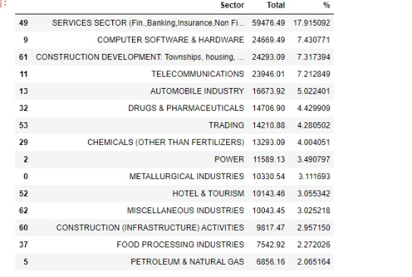
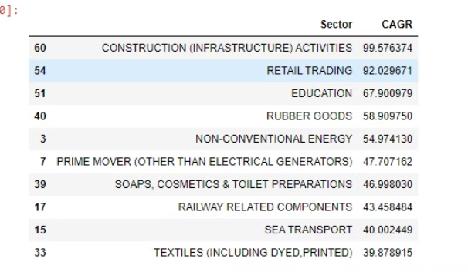
Insights

Slide 6
Insights
The highest investment has been made in the Services sector, which includes Finance, Banking, Insurance, Non-Financial Business, Outsourcing, R&D, Courier, Tech Testing and Analysis, and Other, amounting to ₹59,476.5.
OUT OF THE TOTAL INVESTMENT INFLOW NEARLY 17.9% HAS BEEN INVESTED IN SERVICES SECTOR, which includes Finance, Banking, Insurance, Non-Financial Business, Outsourcing, R&D, Courier, Tech Testing and Analysis
NEARLY 7.4% HAS BEEN INVESTED IN COMPUTER TECHNOLOGIES

Slide 7
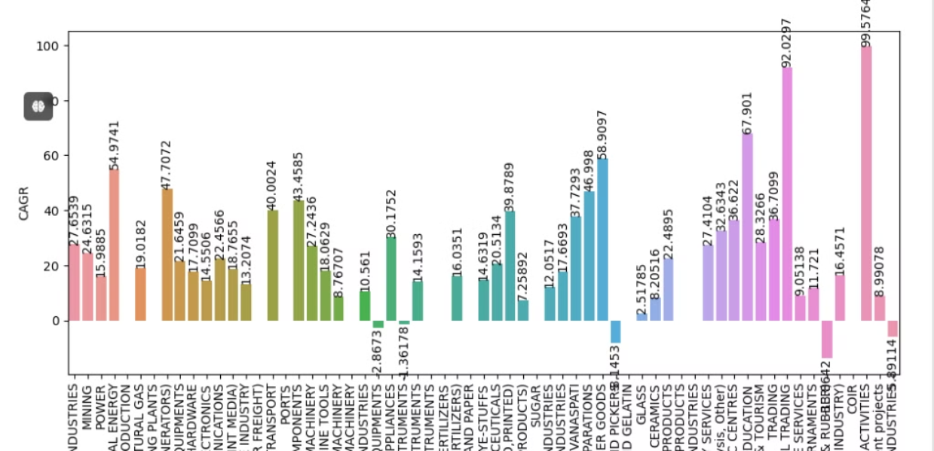
Insights
CONSTRUCTION ACTIVITIES HAS SHOWN MOST CAGR(Compound Annual Growth Rate) of 99.57%.
COMMERCIAL,OFFICE & HOUSEHOLD EQUIPMENTS,INDUSTRIAL INSTRUMENTS,LEATHER,LEATHER GOODS AND PICKERS,TEA AND COFFEE,MISCELLANEOUS INDUSTRIES .All these sectors have shown a negative CAGR.

Slide 8

Thank You

